Slide 1
Hand Gesture Translator

Slide 2
Agenda
The problem & solution
Financial & impact Analysis
Technical view (Server, App, Ai Model)
Future plans

Slide 3

The Problem
Number of deaf & mute in the world
2. Deaf & mute communication problems
3. Lack of sign language awareness

Slide 4
The Solution
Sign language schools and dictionary
2. Ex. Solutions
3. Problems in Ex. Solution
4. Our Solution for this problem

Slide 5
Financial & Stakeholders Analysis
Stakeholders & Roles
Deaf/Mute Users: Primary beneficiaries who need accessibility tools.
Educators/Schools: Use in special education to support learning and inclusion.
NGOs & Foundations: Provide funding and help with broader distribution.
Tech Partners: Handle deployment, cloud services, and technical support.
Financial Model
Freemium model — Free for personal use, paid for institutions (schools).
Market Size
~70 million people globally use sign language.
ROI & Impact
Low development cost and high scalability via app stores.
Can improve communication for thousands daily — especially in schools and public offices.

Slide 6
Technical view (Server, App, Ai Model)

Slide 7
Server (Fast API)
Server Responsibilities
Handles communication between frontend and AI model
Receives image frames or video from the app
Forwards frames to the AI model Sends back predicted text to frontend
Maintains real-time, low-latency communication
Technology Stack
Component Tool
Language Python
Framework FastAPI
Communication WebSockets
Image Processing OpenCV
Data Transfer base64 (image)

Slide 8
Server (Fast API)
Challenges & Solutions
Challenge Solution
Real-time performance WebSockets over HTTP
Image data transfer JPEG + base64 encoding
Cross-platform access CORS & mobile support in FastAPI
Testing without frontend Python prototype client

Slide 9
App (Flutter)
1. Application usage
2. Why Flutter
3. Camera access & usage
4. Data Transfer

Slide 10

App (Flutter)
1. Why Web Sockets
2. Image Processing (Base64)
3.Send & receive

Slide 11
Ai Model
What the AI Model Does
The AI model is the “brain” of our system.
It looks at the user's hand signs and understands what letter they mean.
It works on a server, so the app stays fast and small.
It helps deaf and mute people turn signs into ASL letters in real time.

Slide 12
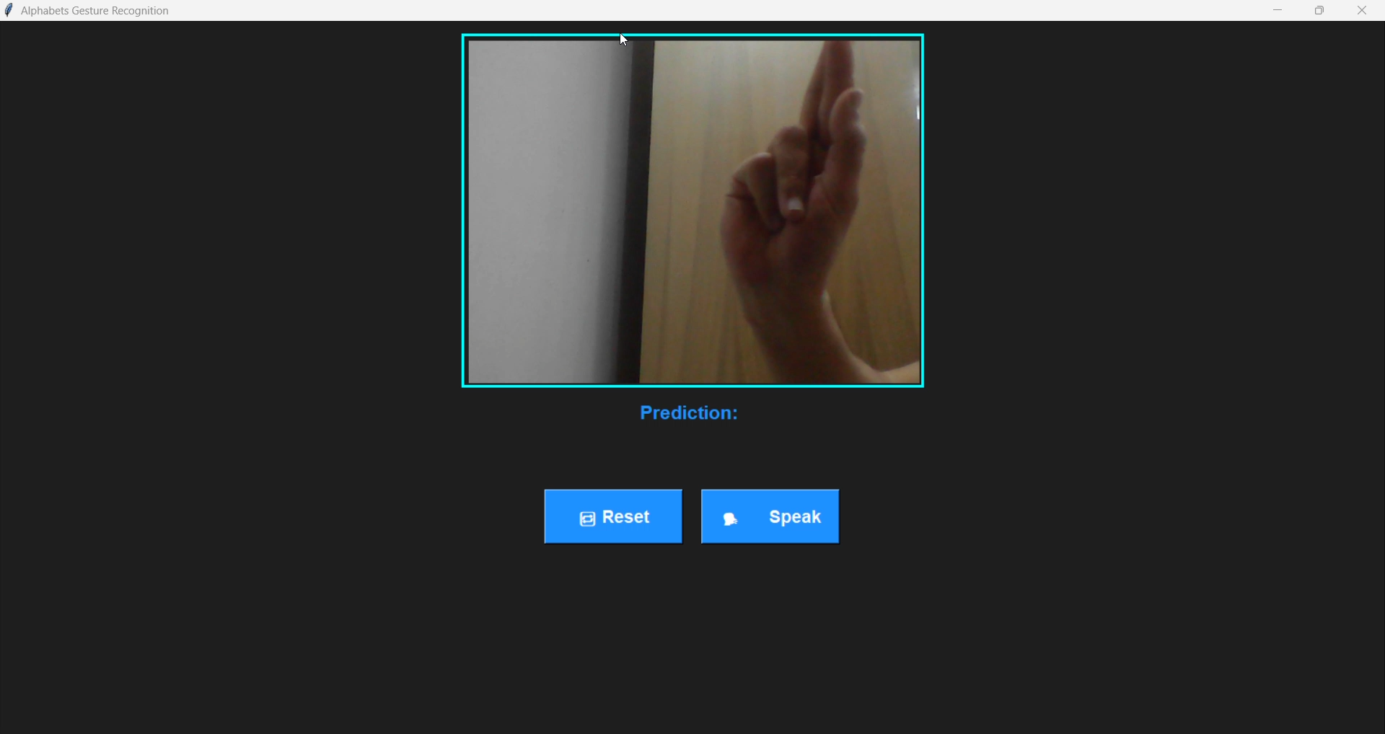
This is a Prototype for the Ai model using laptop camera

Slide 13
Ai Model
How We Built the AI Model
We collected hand sign images for ASL letters, Arabic letters, and numbers.
We trained the model using Random Forest, a smart algorithm that makes accurate decisions.
After training, we uploaded the models to the server.
The app sends a hand image to the server, and the AI replies with the correct letter, number, or Arabic letter.
These models are ready for use or future updates.

Slide 14


Future plans
Ai
Educational
Upgrade to deep learning models (e.g., CNNs) for higher accuracy
Enable full-word recognition using continuous gesture input
Build a visual dictionary for:
Children
Elderly individuals
New learners
Include animations aids to support learning
Strategic Partnerships
Collaborate with key organizations in Egypt:
Ministry of Education
Associations for the Deaf and Mute
focus on inclusion in schools and awareness programs

Slide 15
Thank you
DATA DIVERS
Ahmed Mohamed Ibrahim Doha Ayman Youssef Rana Ahmed Hussein Abdelrahman Ezzat Mahmoud Hossam Aldin

